Slide 1

Team 13 - Banking & Financial Service Management
TEAM MEMBERS
Ankita Kumari NUID : 002929668
Hazel Lobo NUID : 001001740
Sanjana Chatti NUID : 002105435
Achyuth Varma NUID : 002960283
Vachana Belgavi NUID : 002101078

Slide 2

Problem Statement
Before the database was built, employees in the bank had to manually write and store the banking records inside the files. This procedure is highly redundant, arduous and inefficient, especially while retrieving the important information. Therefore, a strong, robust database management system must be made to address this issue.
The main goal of our system is to design a database model such that it’ll help the organization with information of various services opted by the customers from a particular bank branch and help the bank employees to have a smooth experience for providing additional services.

Slide 3

Proposed Solution
• Allow bank employees and customers to easily set up a bank account and provide additional services like loans, insurances, and cards
• Customers have the freedom to choose any type of loan, insurance, and card
• Customers can raise the request for the service and bank employees can approve or decline that request based on customer’s financial background
• Allows bank employees and customers to track recent transactions made
• Display statistical data to all the managers (Ex: Accounts created, different services availed, customer with poor credit scores, most popular branch, etc.)
• Allow customers to look up the status of the services that they have opted for in real time

Slide 4
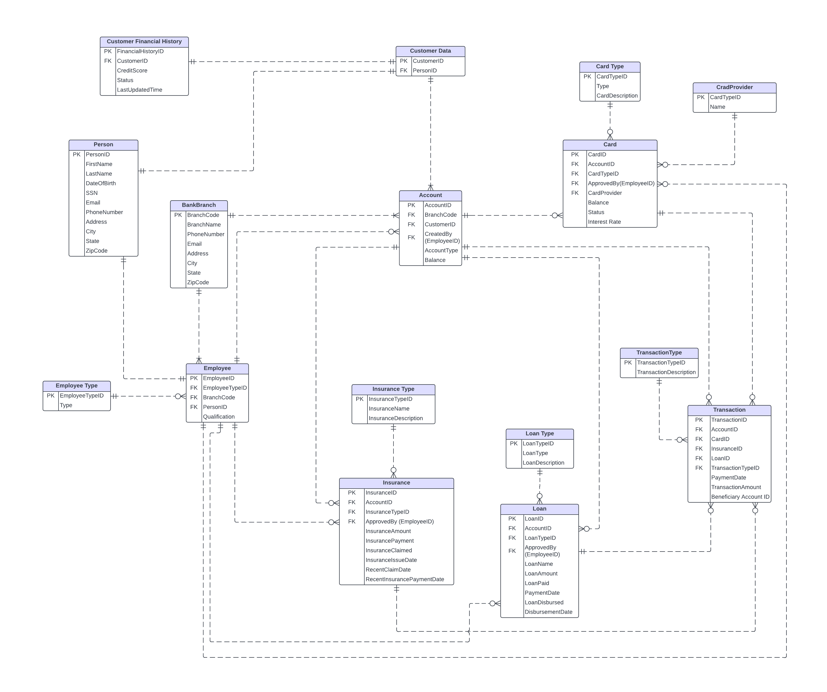
ER Diagram
Each branch offers services like loans, insurance, and cards
A Bank employee may add, update, and validate customers' details
A Bank employee may approve the loan, insurance, card requests made by customers based on their financial history
Customer can have one or more accounts (Checking or Savings)
Each account is linked to one and only one Customer
Customer may opt for multiple services like loan, insurance, and card services
A Customer may transfer money to other accounts, request for loan and insurance, and perform card transactions
A service can have multiple transactions
A service can be of different types. Ex. Different types of loan, insurance, and card
One account can have zero or many transactions.

Slide 5
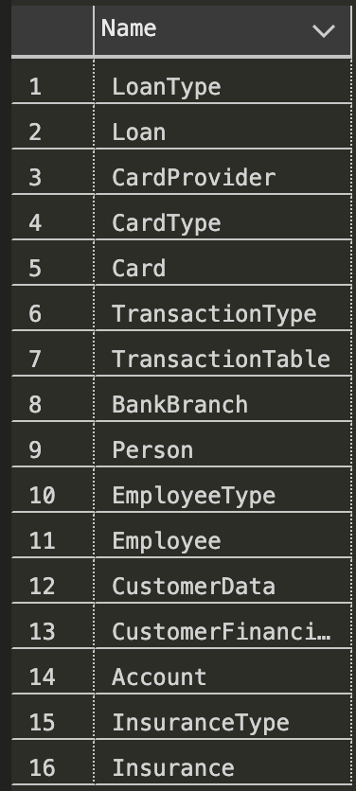

Database Tables

Slide 6
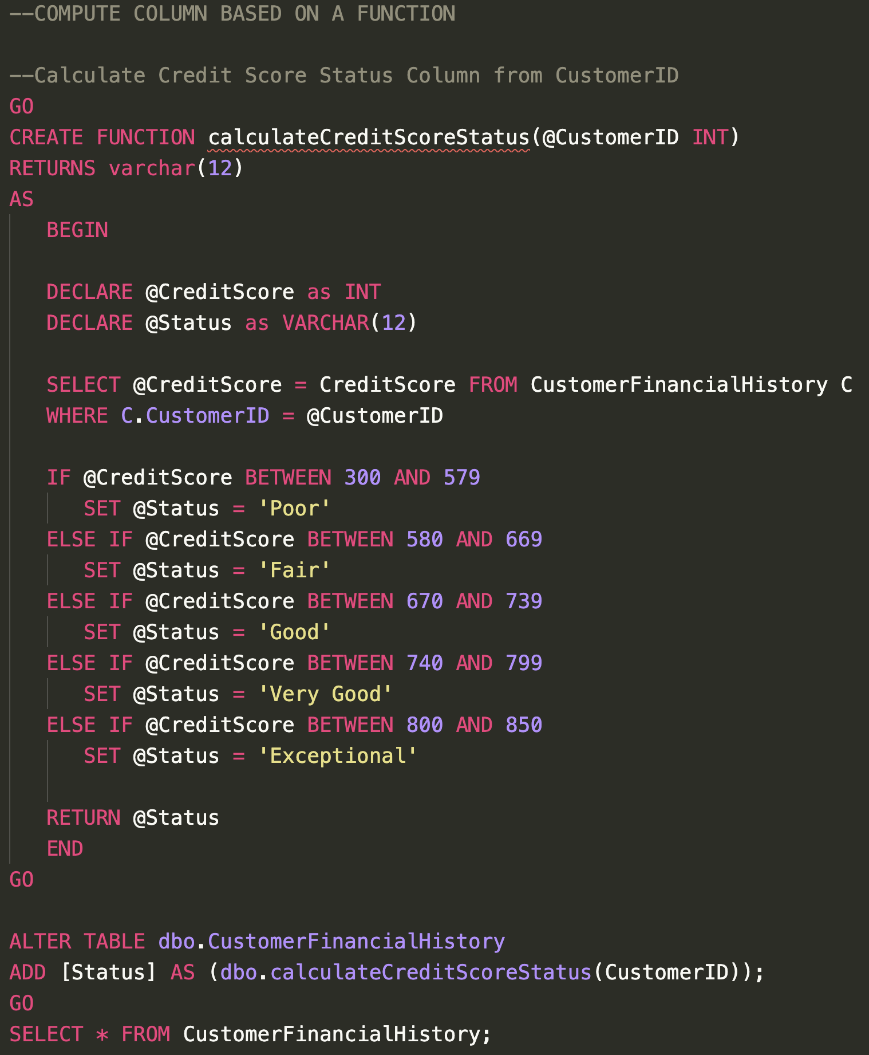

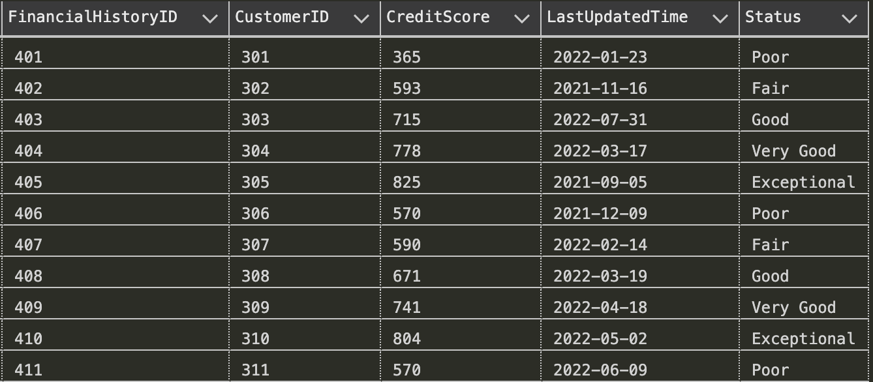
Column Based Computation

Slide 7
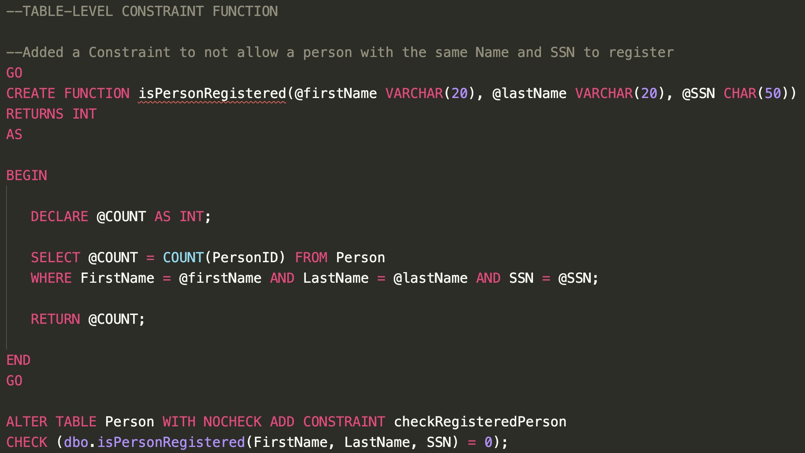

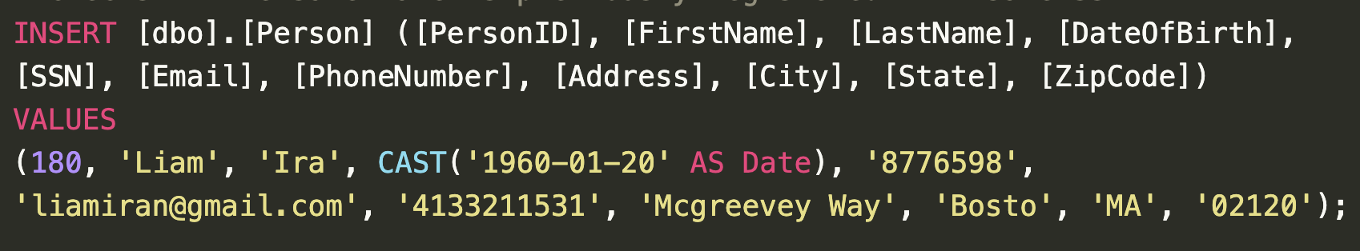
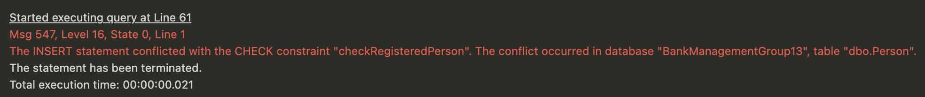
Table Level Constraint
The CHECK constraint prevents insertion of Person data with same name and SSN

Slide 8
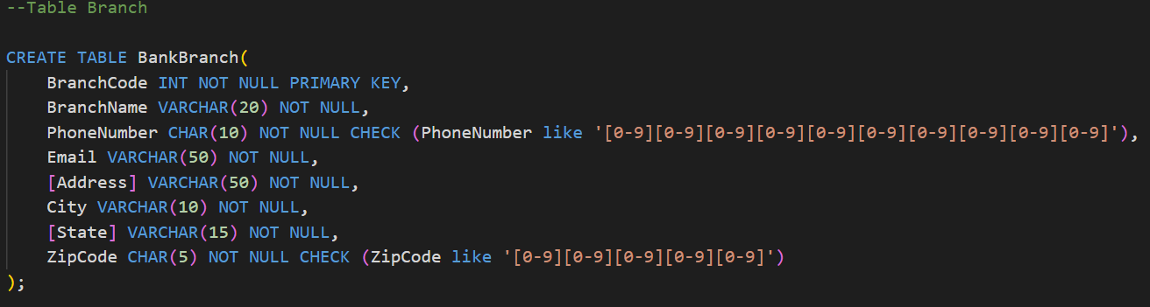
Inline Constraint

Slide 9
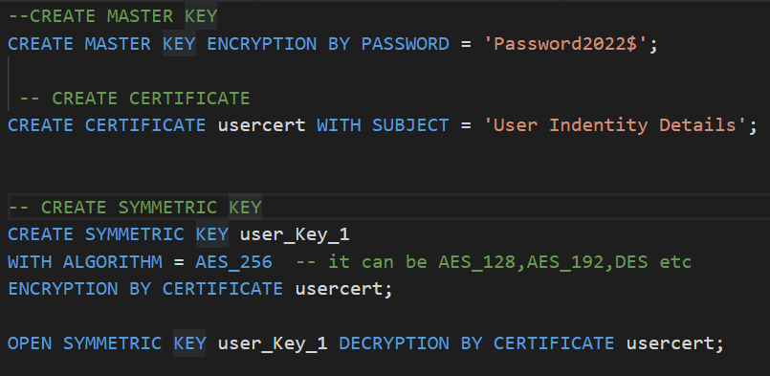
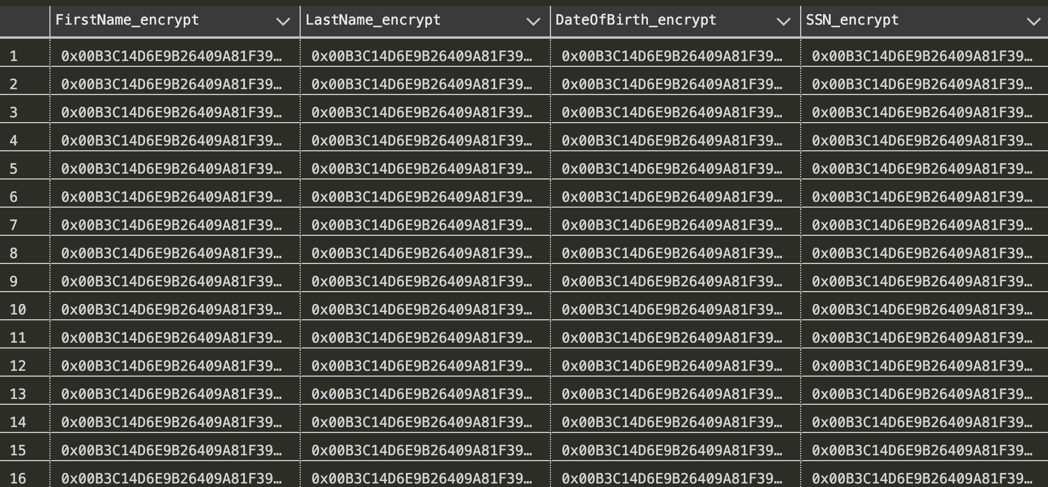
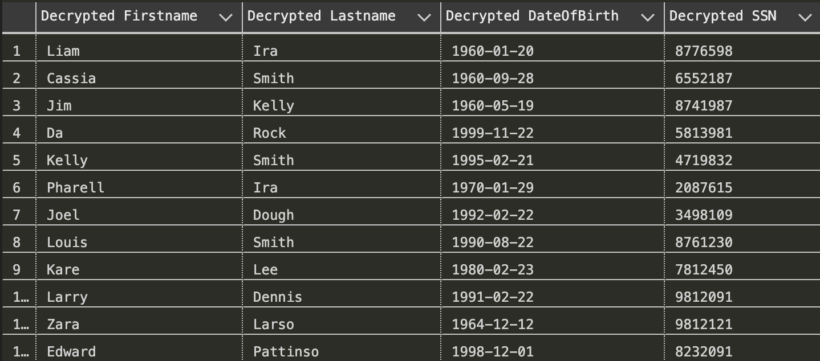

Encryption & Decryption
Encryption of Person Details table
Hence preventing identity theft

Slide 10
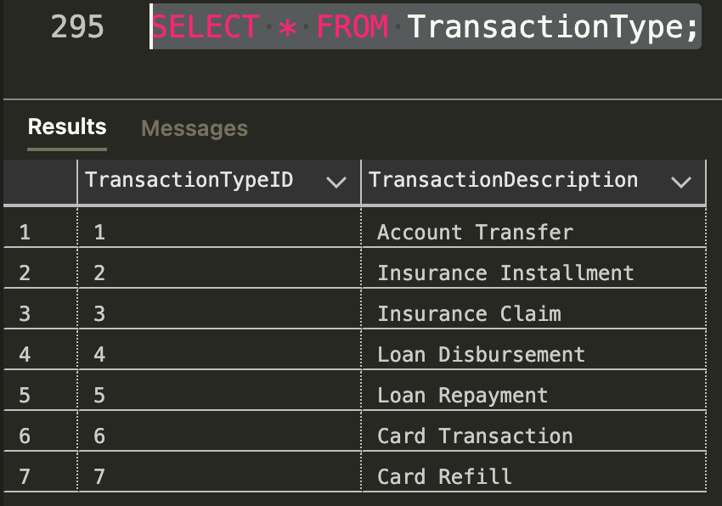

Types of Transactions

Slide 11
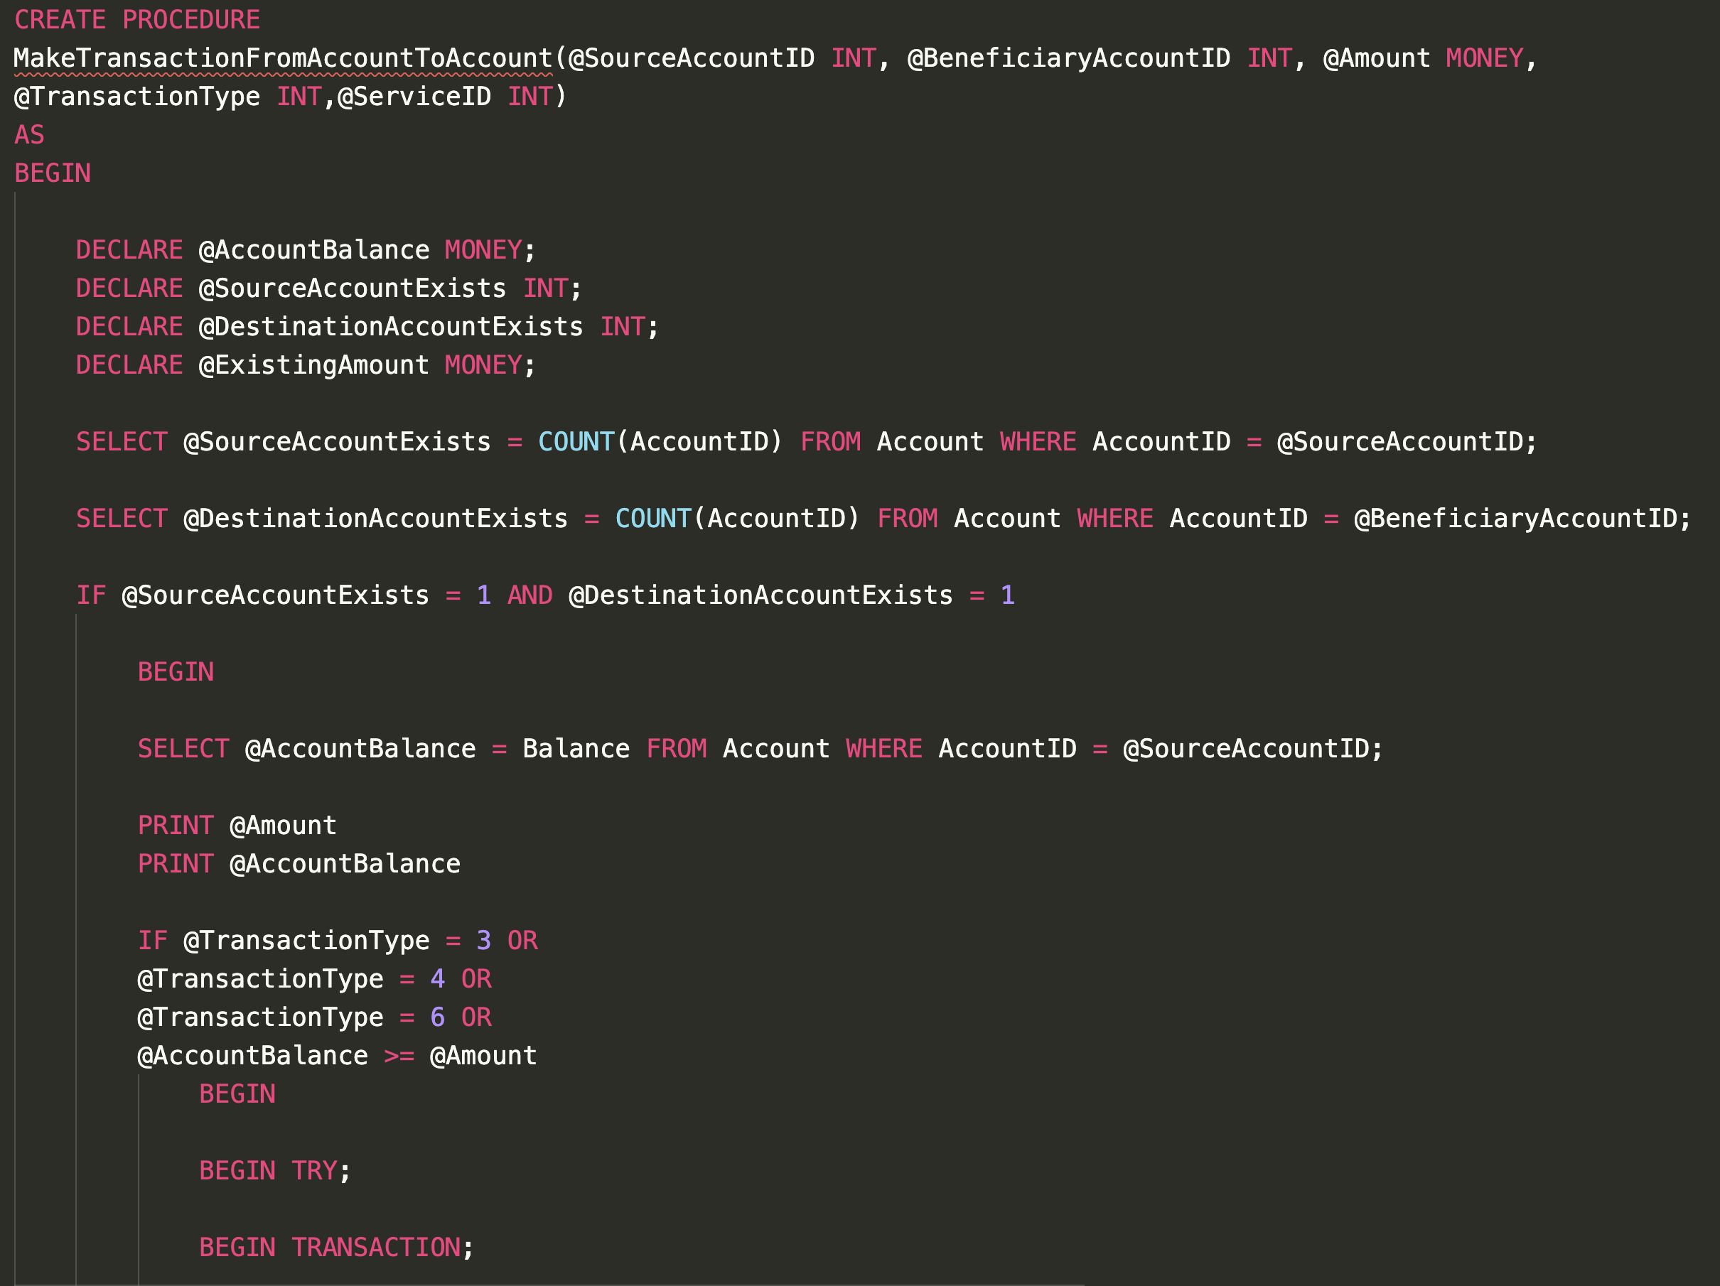
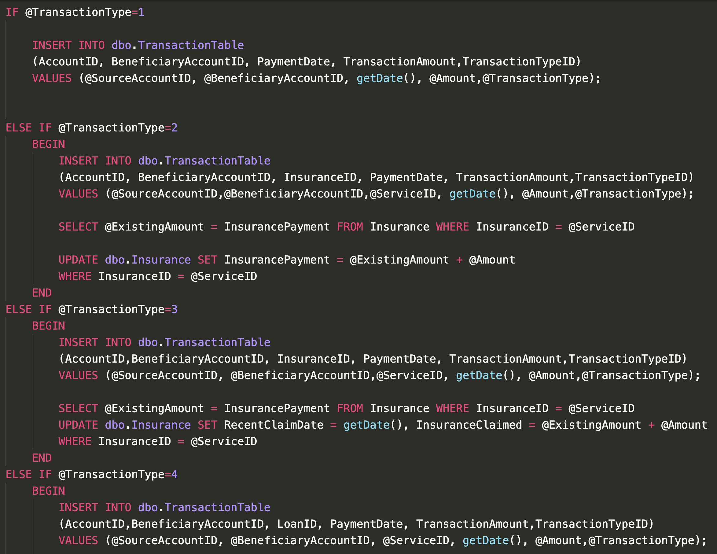
Procedure - 1

Slide 12
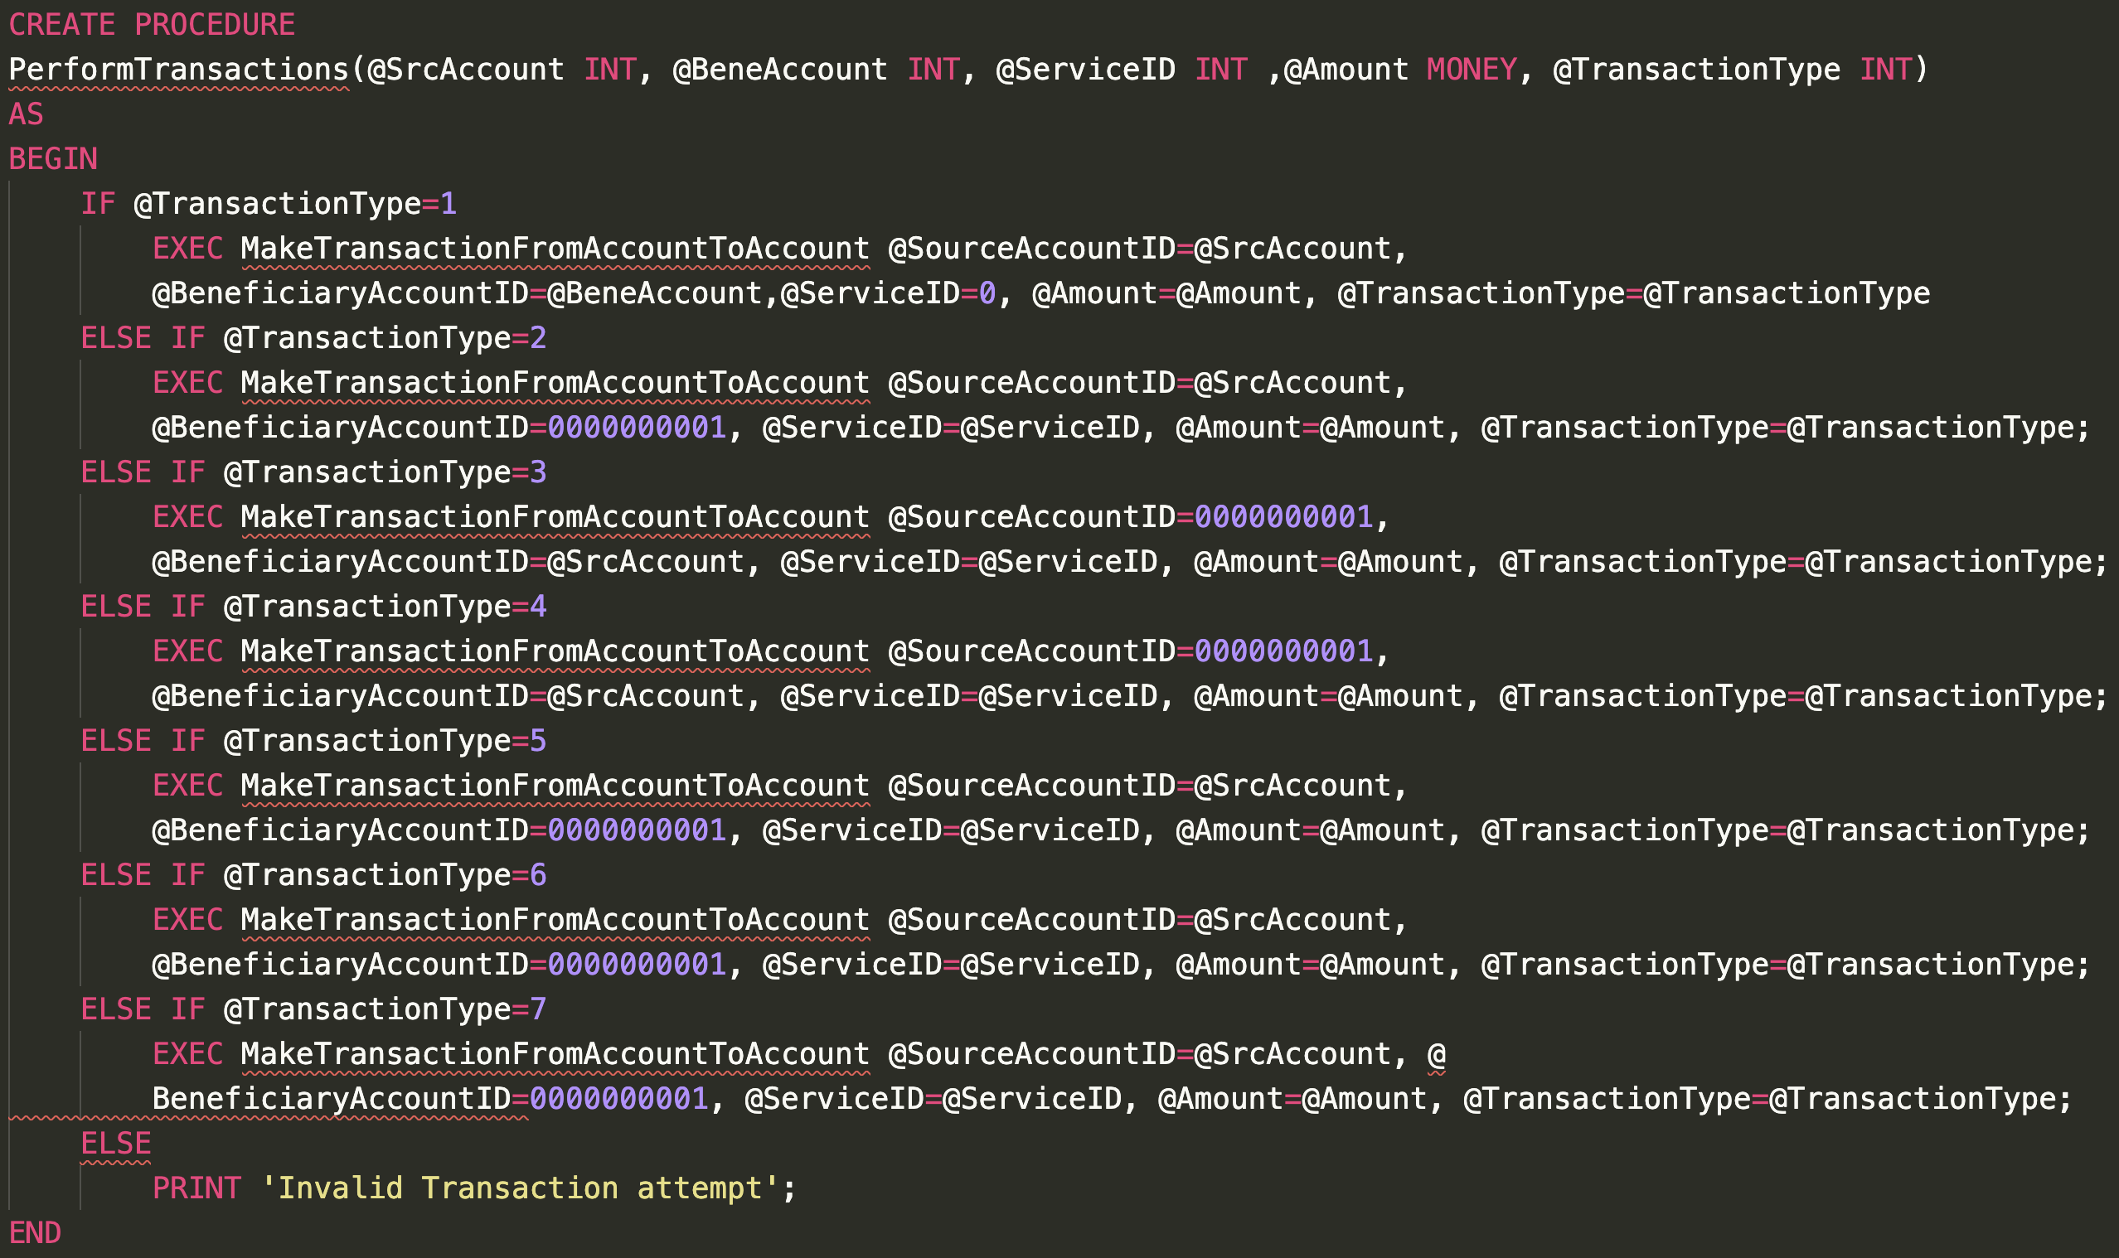
Procedure - 2

Slide 13
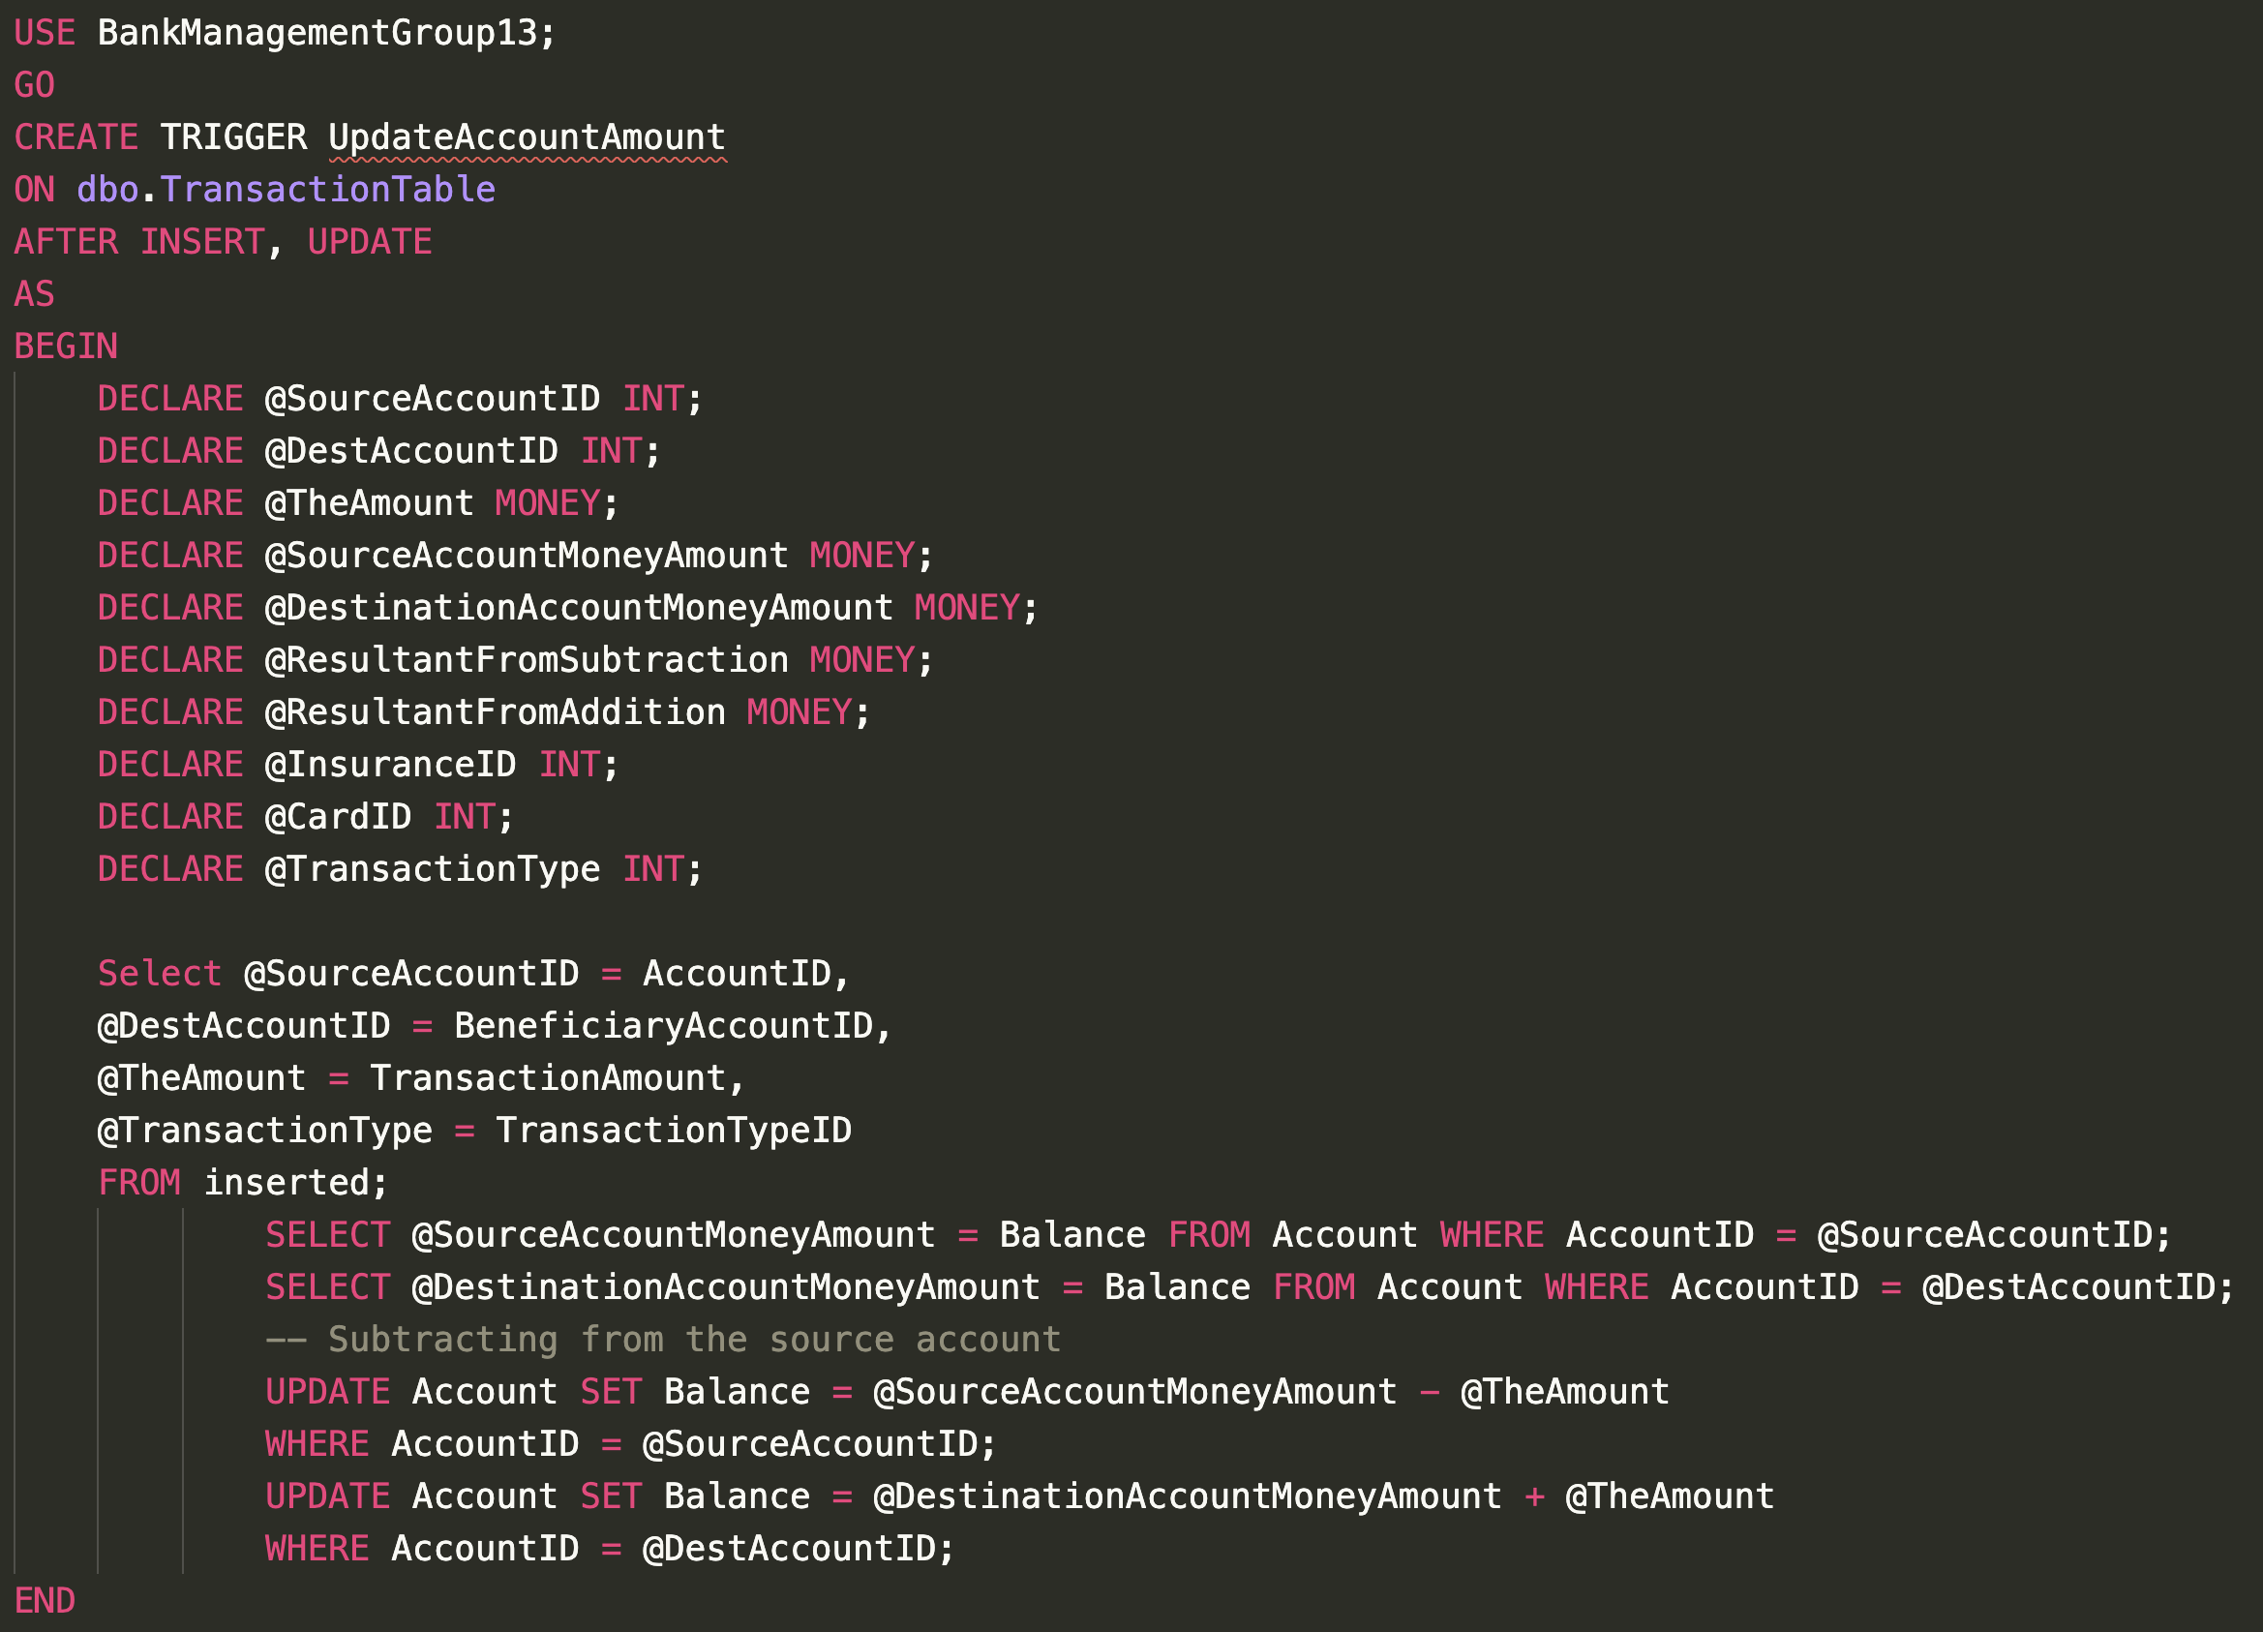
Triggers
This trigger updates the balance inside the Account Table whenever a new Transaction is performed. Thus, maintaining consistency in balance amount.

Slide 14
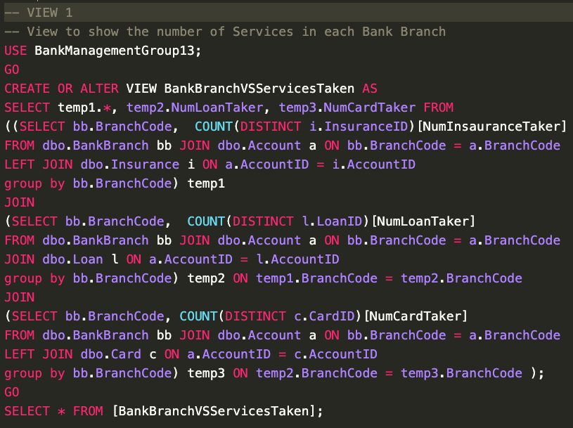
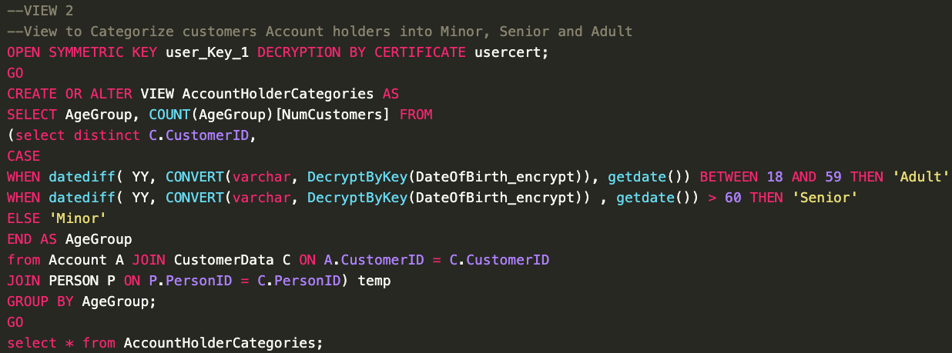
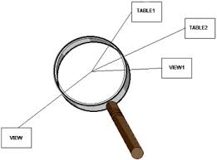
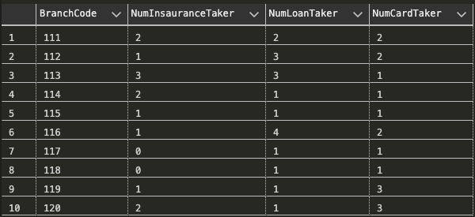
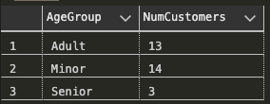
Views

Slide 15
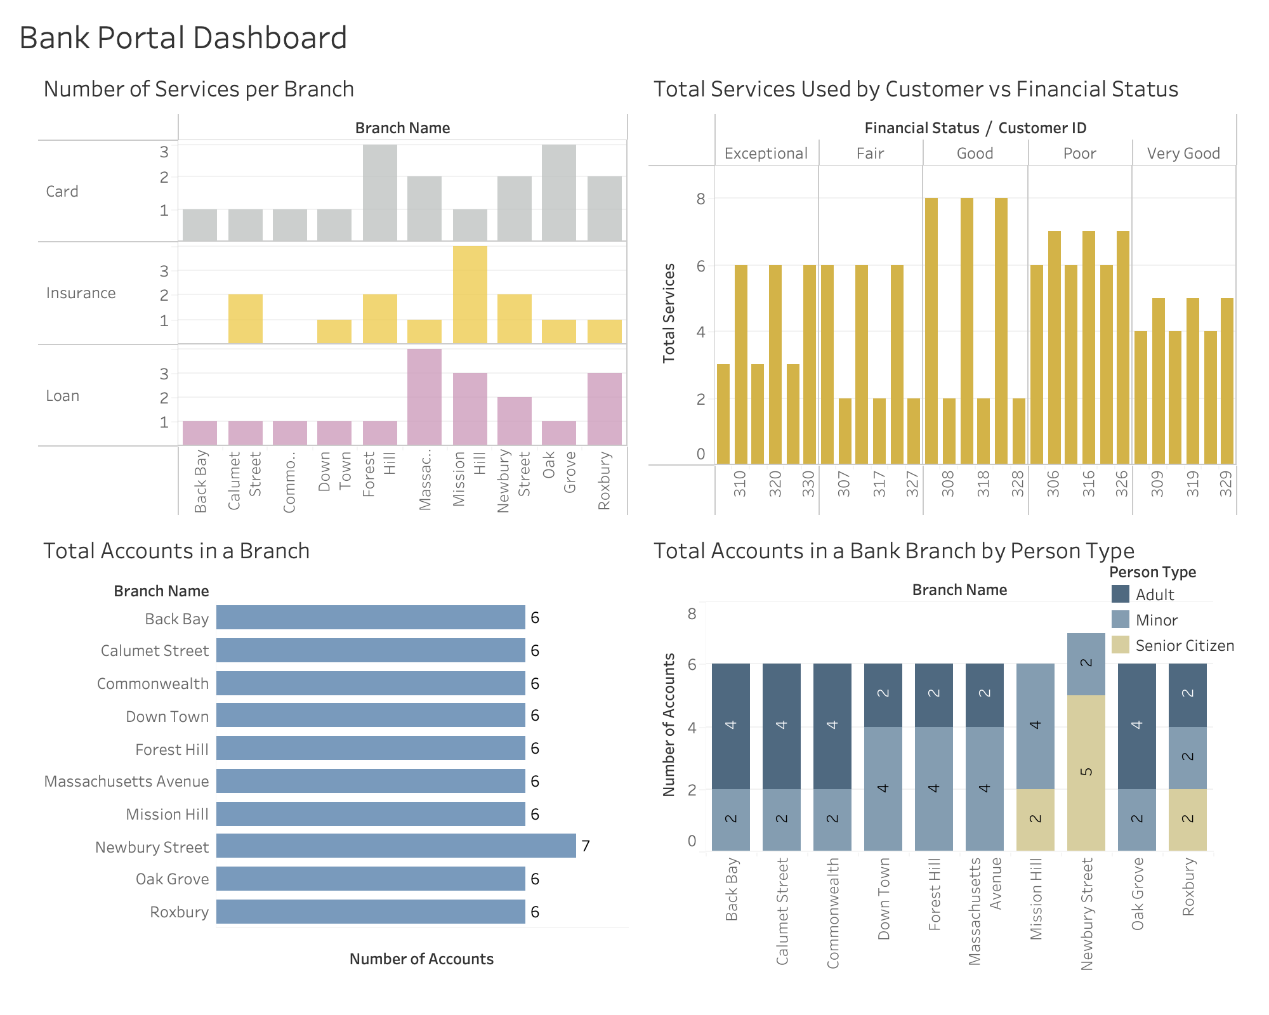
Dashboard

Slide 16


